Slide 1

SE401 - Software Quality Assurance and Testing
Mobile Testing

Slide 2
Outline
What is a Mobile Application?
Mobile Testing vs. Mobile Application Testing
Why Perform Mobile Application Testing
Challenges in Mobile Application Testing
Types of Mobile Application Testing

Slide 3

Mobile Application
A mobile application is a software application developed specifically for use on small, wireless, handheld mobile devices such as smart-phones and tablets.
Mobile apps are available through application distribution platforms which are typically operated by the owner of the mobile operating system, such as the App Store (iOS) or Google Play Store.

Slide 4
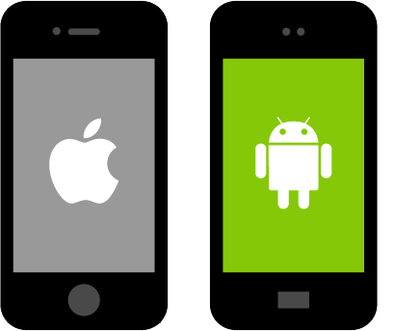
Main Mobile Phone Platforms

Slide 5
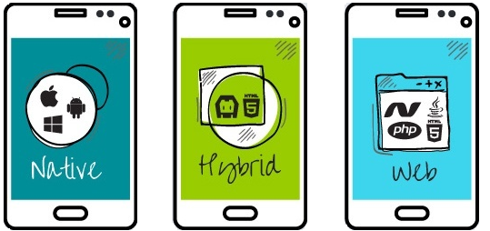
Mobile Application
Types of Mobile Applications:
Native Applications:
Mobile Web Applications
Hybrid applications

Slide 6

Mobile Application
Native Apps:
Are installed through different mobile platforms stores (Google Play Store or Apple’s app store).
Are Platform specific
Offers fast, most reliable and most responsive experience to the users.
Examples: Pinterest, Facebook, and Pokémon Go.

Slide 7

Mobile Application
Mobile Web Apps:
Are server-side apps to access website/s on mobile using different browsers like Chrome, Firefox by connecting to a mobile network or wireless network like Wi-Fi.
Developing web apps is simple and quicker than Native apps
Slower and less intuitive comparted to Native apps.

Slide 8

Mobile Application
Hybrid Apps:
Are combinations of native app and web app. (You install it like a native app, but it’s a web app on the inside).
They run on devices or offline and are written using web technologies like HTML5 and CSS.
Hybrid apps examples: Instagram, Uber, Evernote.

Slide 9

Mobile vs Mobile Application Testing
Mobile Testing:
Testing the mobile device (the hardware) including the internal processors, internal hardware, screen sizes, resolution, space or memory, camera, radio, Bluetooth, WIFI etc.
Mobile Application Testing:
Testing the applications (software) that work on mobile devices and their functionality.

Slide 10

Mobile Application Testing
Mobile application testing is a process by which application software developed for handheld mobile devices is tested for its functionality, usability and consistency.
Mobile application testing can be an automated or manual type of testing.

Slide 11
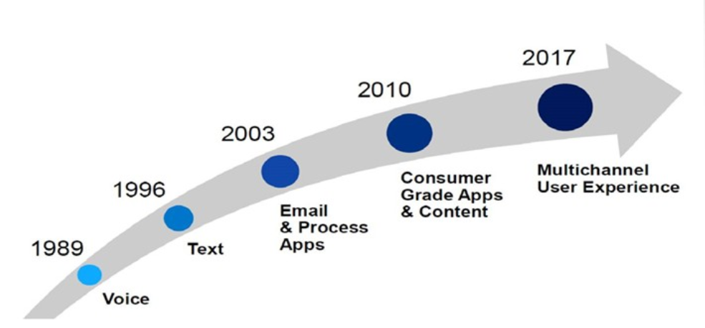
Why Testing Mobile Apps is Important

Slide 12
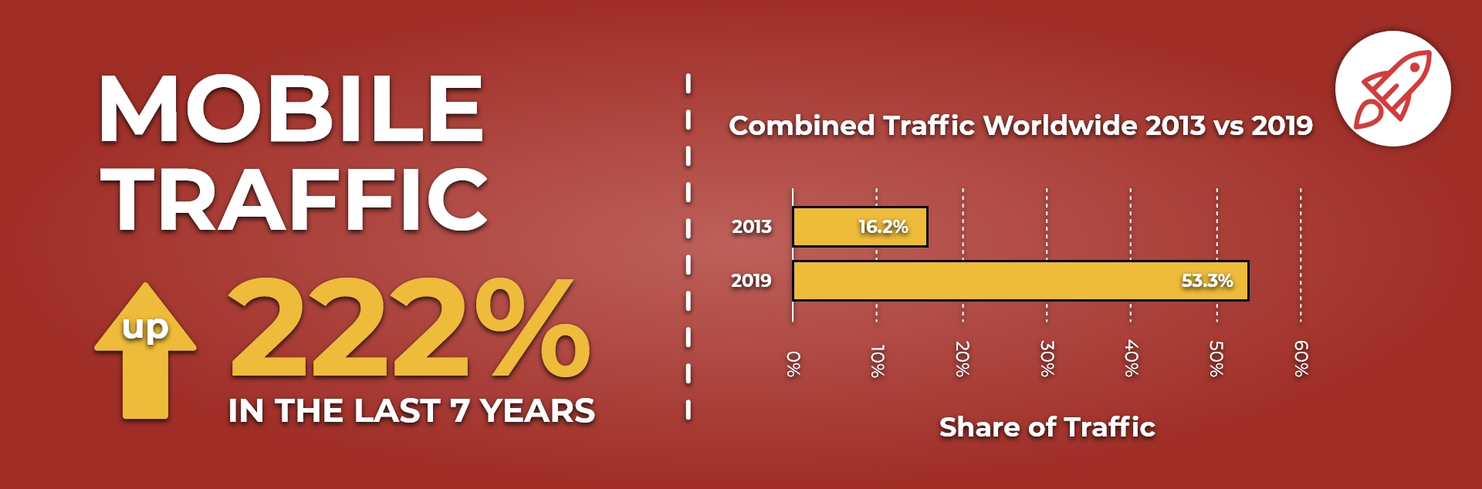
Why Testing Mobile Apps is Important

Slide 13

Challenges in Mobile App testing
Issues that make testing mobile applications more challenging:
Variety of mobile devices available in the market (i.e. HTC, iPhone, Samsung, etc.. )
Diverse mobile operating platforms used (iOS, Android)
Different network service providers
Different input methods
Hardware compatibility

Slide 14
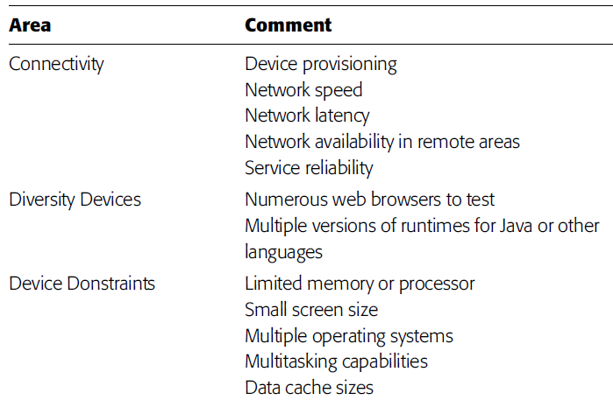
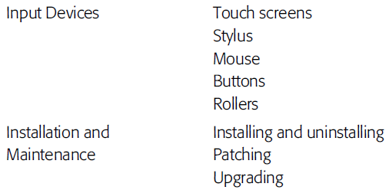
Mobile Environment Test Design Considerations

Slide 15
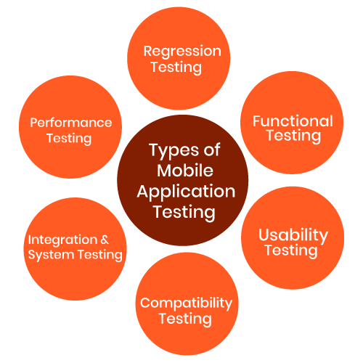
Major Types of Mobile Apps testing

Slide 16
Functional Testing
Consists of
testing user interactions
testing the transactions
Relevant factors:
Type of application (banking, gaming, social or business)
Target audience type (consumer, enterprise, education)
Distribution channel (e.g. Apple App Store, Google play, direct distribution)

Slide 17
Functional Testing Scenarios (1)
mandatory fields are working as required
mandatory fields are displayed distinctively from the non-mandatory fields
the application works as per as requirement whenever the application starts/stops
the application goes into minimized mode whenever there is an incoming phone call
the phone is able to store, process and receive SMS whenever the app is running
the device is able to perform required multitasking requirements whenever it is necessary to do so

Slide 18
Functional Testing Scenarios (2)
the application allows necessary social network options such as sharing, posting and navigation etc.
the application supports any payment gateway transaction such as Visa, Mastercard, Paypal etc.
the page scrolling scenarios are being enabled in the application as necessary
the navigation between relevant modules in the application are as per the requirement
the truncation errors are absolutely to an affordable limit
the user receives an appropriate error message like “Network error. Please try after some time” whenever there is any network error

Slide 19
Functional Testing Scenarios (3)
allows other applications to perform satisfactorily, and it does not eat into the memory of the other applications
resumes at the last operation in case of a hard reboot or system crash
Installation can be done smoothly provided the user has the necessary resources and it does not lead to any significant errors
performs auto start facility according to the requirements
performs according to the requirement in all versions of Mobile that is 2g, 3g,4g and 5g
Regression Testing to uncover new software bugs in existing areas of a system after changes have been made to them.
provides an available user guide for those who are not familiar to the app

Slide 20
Performance Testing
Fundamental objective is to ensure that the application performs acceptably under certain performance requirements such as access by a huge number of users or the removal of a key infrastructure part like a database server.

Slide 21
Performance Testing Scenarios (1)
performs as per the requirement under different load conditions
the current network coverage is able to support the application at peak, average and minimum user levels
the existing client-server configuration setup provides the required optimum performance level
identify the various application and infrastructure bottlenecks which prevent the application to perform at the required acceptability levels
validate whether the response time of the application is as per as the requirements

Slide 22
Performance Testing Scenarios (2)
evaluate product and/or hardware to determine if it can handle projected load volumes
evaluate whether the battery life can support the application to perform under projected load volumes
validate application performance when network is changed to WIFI from 3G/4G or vice versa
validate that the battery consumption, memory leaks, resources like GPS, Camera performance is well within required guidelines

Slide 23
Performance Testing Scenarios (3)
validate the application longevity whenever the user load is rigorous
validate the network performance while moving around with the device
validate the application performance when only intermittent phases of connectivity is required

Slide 24
Security Testing
The fundamental objective of security testing is to ensure that the application’s data and networking security requirements are met as per guidelines

Slide 25
Security Testing Scenarios (1)
able to withstand any brute force attack which is an automated process of trial and error used to guess a person’s username, password or credit-card number
not permitting an attacker to access sensitive content or functionality without proper authentication
has a strong password protection system and it does not permit an attacker to obtain, change or recover another user’s password
does not suffer from insufficient session expiration
identify the dynamic dependencies and take measures to prevent any attacker for accessing these vulnerabilities

Slide 26
Security Testing Scenarios (2)
prevent from SQL injection related attacks
identify and recover from any unmanaged code scenarios
certificates are validated, does the application implement Certificate Pinning or not
protect the application and the network from the denial of service attacks
analyze the data storage and data validation requirements
enable the session management for preventing unauthorized users to access unsolicited information

Slide 27
Security Testing Scenarios (3)
check if any cryptography code is broken and ensure that it is repaired
validate whether the business logic implementation is secured and not vulnerable to any attack from outside
analyze file system interactions, determine any vulnerability and correct these problems
validate the protocol handlers for example trying to reconfigure the default landing page for the application using a malicious iframe
protect against malicious client side injections
protect against malicious runtime injections

Slide 28
Security Testing Scenarios (4)
investigate file caching and prevent any malicious possibilities from the same
prevent from insecure data storage in the keyboard cache of the applications
investigate cookies and preventing any malicious deeds from the cookies
provide regular audits for data protection analysis
investigate custom created files and preventing any malicious deeds from the custom created files
prevent from buffer overflows and memory corruption cases
analyze different data streams and preventing any vulnerabilities from these

Slide 29
Usability Testing
The usability testing process of the Mobile application is performed to have a quick and easy step application with less functionality than a slow and difficult application with many features
The main objective is to ensure that we end up having an easy-to-use, intuitive and similar to industry-accepted interfaces which are widely used

Slide 30
Usability Testing Scenarios (1)
buttons should have the required size and be suitable to big fingers
buttons are placed in the same section of the screen to avoid confusion to the end users
icons are natural and consistent with the application
buttons, which have the same function should also have the same color
validation for the tapping zoom-in and zoom-out facilities should be enabled
keyboard input can be minimized in an appropriate manner

Slide 31
Usability Testing Scenarios (2)
application provides a method for going back or undoing an action, on touching the wrong item, within an acceptable duration
contextual menus are not overloaded because it has to be used quickly
text is kept simple and clear to be visible to the users
short sentences and paragraphs are readable to the end users
font size is big enough to be readable and not too big or too small
application prompts the user whenever the user starts downloading a large amount of data which may be not conducive for the application performance

Slide 32
Usability Testing Scenarios (3)
closing of the application is performed from different states and verify if it re-opens in the same state
all strings are converted into appropriate languages whenever a language translation facility is available
application items are always synchronized according to the user actions
end user is provided with a user manual which helps the end user to understand and operate the application who may be not familiar with the application’s proceedings

Slide 33
Compatibility Testing
Compatibility testing on mobile devices is performed to ensure that since mobile devices have different size, resolution, screen, version and hardware so the application should be tested across all the devices to ensure that the application works as desired

Slide 34
Compatibility Testing Scenarios
user Interface of the application is as per the screen size of the device, no text/control is partially invisible or inaccessible
text is readable for all users for the application
call/alarm functionality is enabled whenever the application is running. The application is minimized or suspended on the event of a call and then whenever the call stops the application is resumed

Slide 35
Recoverability Testing Scenarios
Crash recovery and transaction interruptions
validation of the effective application recovery situation post unexpected interruption/crash scenarios
verification of how the application handles a transaction during a power failure (i.e. Battery dies or a sudden manual shutdown of the device)
validation of the process where the connection is suspended, the system needs to re-establish for recovering the data directly affected by the suspended connection

Slide 36
Other Testing Scenarios (1)
Installation testing
whether the application can be installed in a reasonable amount of time and with required criterion
Uninstallation testing
whether the application can be uninstalled in a reasonable amount of time and with required criterion
Network test cases
validation of whether the network is performing under required load or not, whether the network is able to support all the necessary applications during the testing procedures
Check Unmapped keys
Check application splash screen

Slide 37
Other Testing Scenarios (2)
Continued keypad entry during interrupts and other times like network issues
Methods which deal with exiting the application
Charger effect while an application is running in the background
Low battery and high performance demand
Removal of battery while an application is being performed
Consumption of battery by application
Check Application side effects

Slide 38
Summary
What is a Mobile Application?
Mobile Testing vs. Mobile Application Testing
Why Perform Mobile Application Testing
Challenges in Mobile Application Testing
Types of Mobile Application Testing

